Slide 1
Digital Portfolio
STUDENT NAME: PRADEEPA S
REGISTER NO AND NMID: 26j241538
DEPARTMENT: BSC-’IT’
COLLEGE: KPR College Of Arts And Science Research

Slide 2
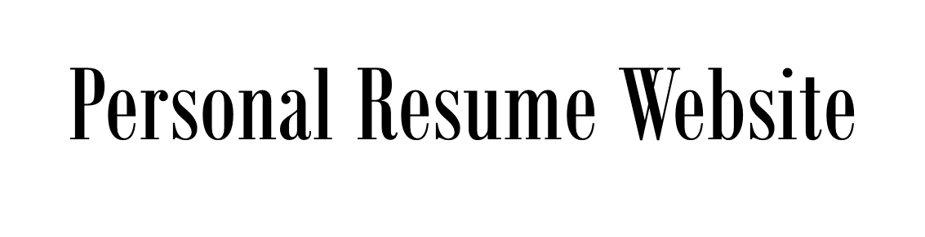
Project Portfolio

Slide 3

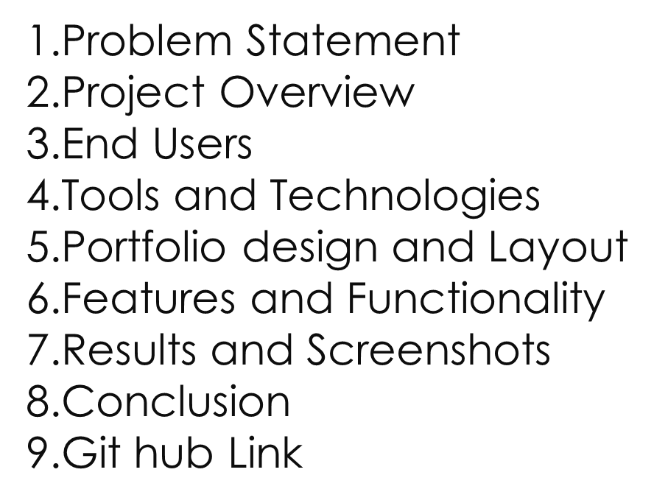
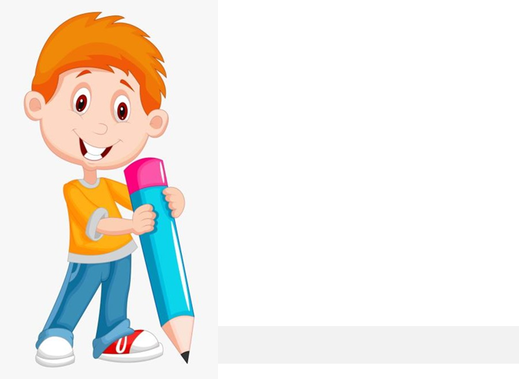

Slide 4

PROBLEM STATEMENT
Traditional resumes are static, limited, and lack creativity.
Job seekers face difficulty in showcasing projects, skills, and achievements effectively on paper.
Recruiters often struggle to get a complete picture of a candidate’s abilities from a text-based CV.
In the digital era, there is a need for a dynamic, accessible, and professional platform to present personal and career information.
Hence, a Personal Resume Website Portfolio is proposed as a solution to create an interactive, visually appealing, and easily shareable resume format.

Slide 5

PROJECT OVERVIEW
During the development process:
Various tools and platforms were reviewed (Wix, WordPress, Google Sites, custom HTML/CSS).
Focus was given to creating a user-friendly interface with clear navigation.
The website was designed to be responsive, ensuring it works across devices (desktop, tablet, mobile).
Content was structured into key sections – About Me, Skills, Education, Projects, Achievements, and Contact.

Slide 6

WHO ARE THE END USERS?
Students & Job Seekers:
To showcase their resume, skills, and projects in an attractive way.Helps in job applications, internships, and higher studies.
Recruiters & Employers:
To quickly evaluate a candidate’s skills, projects, and achievements.Easier access to a candidate’s portfolio compared to traditional resumes.
Freelancers & Professionals:
To highlight their work samples, client projects, and expertise.Useful for networking and gaining new clients.
Academic Institutions:
Can use it for assessing student profiles, projects, and achievements in one place.

Slide 7

TOOLS AND TECHNIQUES
Design & Planning:
Canva / Figma – for designing layout and UI mockups Google Docs / MS Word – for preparing resume content
Website Development:
HTML, CSS, JavaScript – for custom website design Bootstrap / Tailwind CSS – for responsive layout Word Press / Wix / Google Sites – for no-code website creation
Version Control & Hosting:
GitHub – to host portfolio website and manage versions Netlify / Vercel – for free hosting & deployment
Additional Tools:
Photoshop / Canva – for images & graphics LinkedIn / GitHub links – for integration with profile

Slide 8
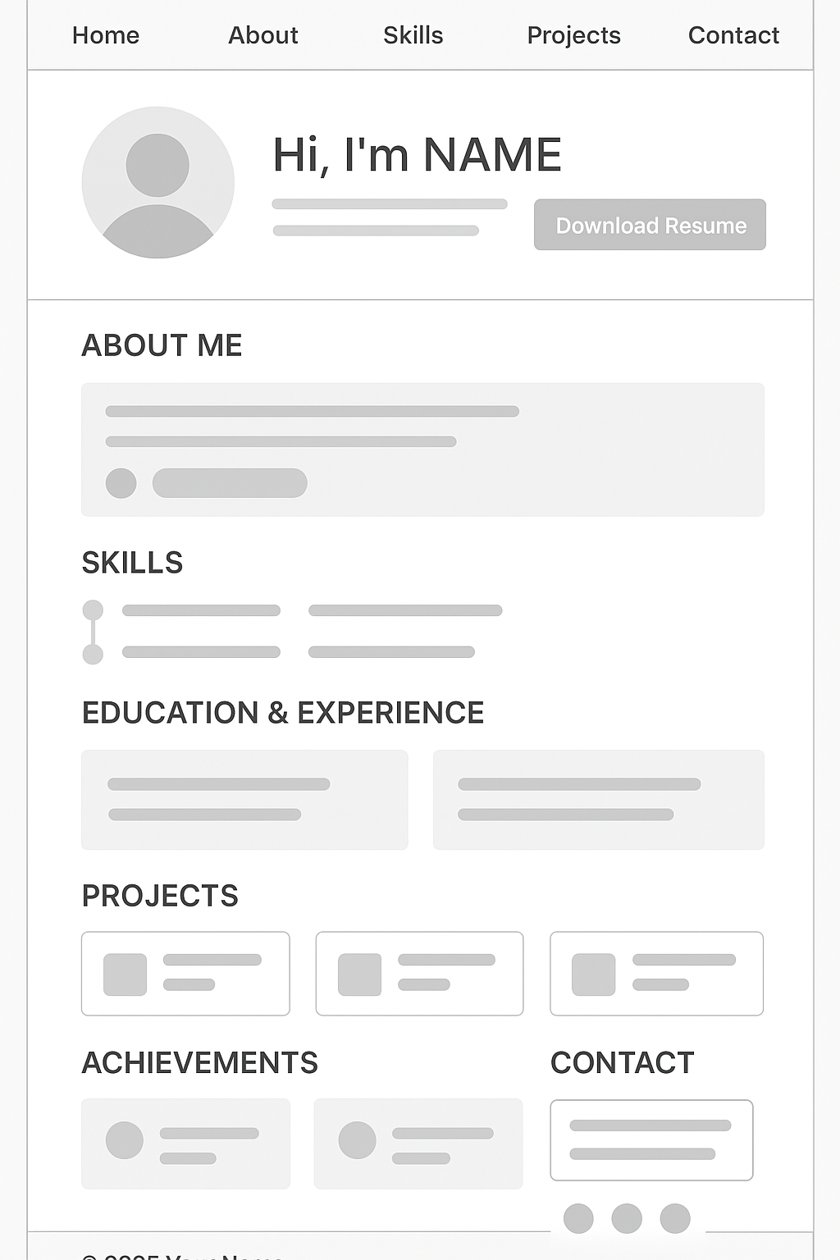
PORTFOLIO DESIGN AND LAYOUT
8

Slide 9
FEATURES AND FUNCTIONALITY
Features of Personal Resume Website Portfolio:
Interactive Resume – dynamic and clickable sections
Responsive Design – works on mobile, tablet, and desktop
Project Showcase – images, links, and descriptions of workEasy Navigation – simple menu for quick access
Contact Integration – form, email, and social linksDownload Resume Option – recruiter can save PDF versionCustomizable Layout colors, fonts, and sections as per need
Personality Reflected in Portfolio
Professionalism → clean and minimal design
Creativity → unique style, personal branding
Clarity → well-organized content, easy readability
Confidence → strong introduction and personal statement
Adaptability → modern digital presence instead of paper-only resume

Slide 10
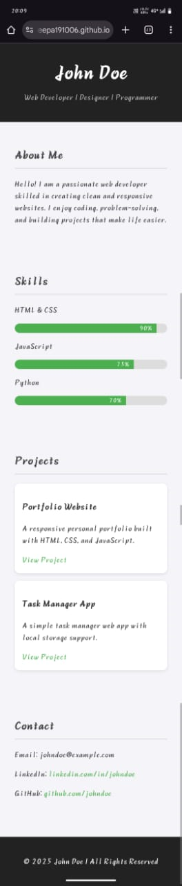

RESULTS AND SCREENSHOTS
https://pradeepa191006.github.io/NM/
3/21/2024 Annual Review
10

Slide 11
CONCLUSION
The personal resume website provides a modern and interactive way to showcase an individual’s skills, qualifications, and achievements. Unlike traditional resumes, it allows dynamic presentation through design, visuals, and interactive features, making it more engaging for employers and recruiters. This project demonstrates how digital portfolios can enhance personal branding, improve visibility, and offer easy accessibility anytime, anywhere. Overall, the personal resume website is a powerful tool for students and professionals to stand out in today’s competitive digital era.
11

